Slide 1
Automatic Test Grading Using Image Processing and Machine Learning Techniques
AP Smit

Slide 2
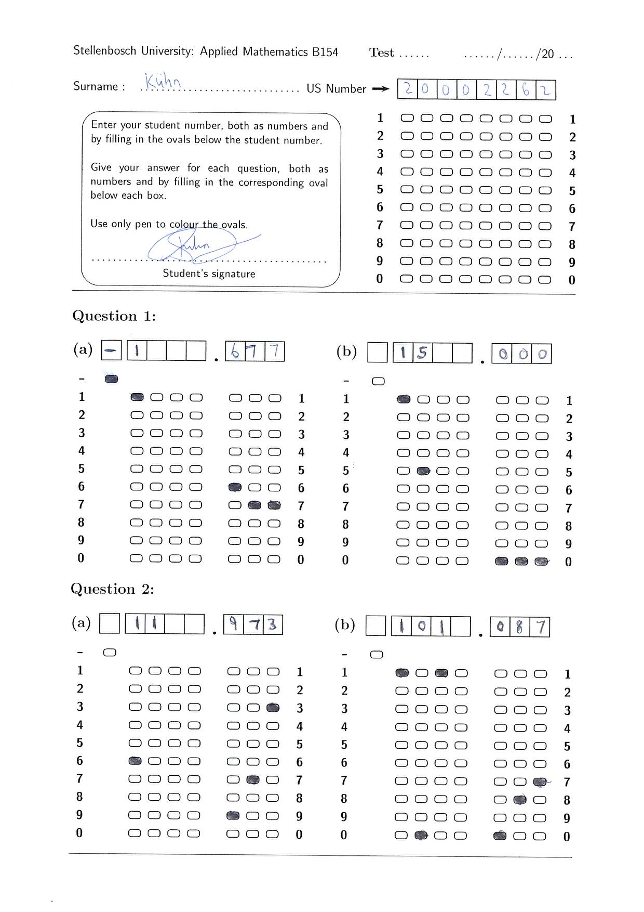
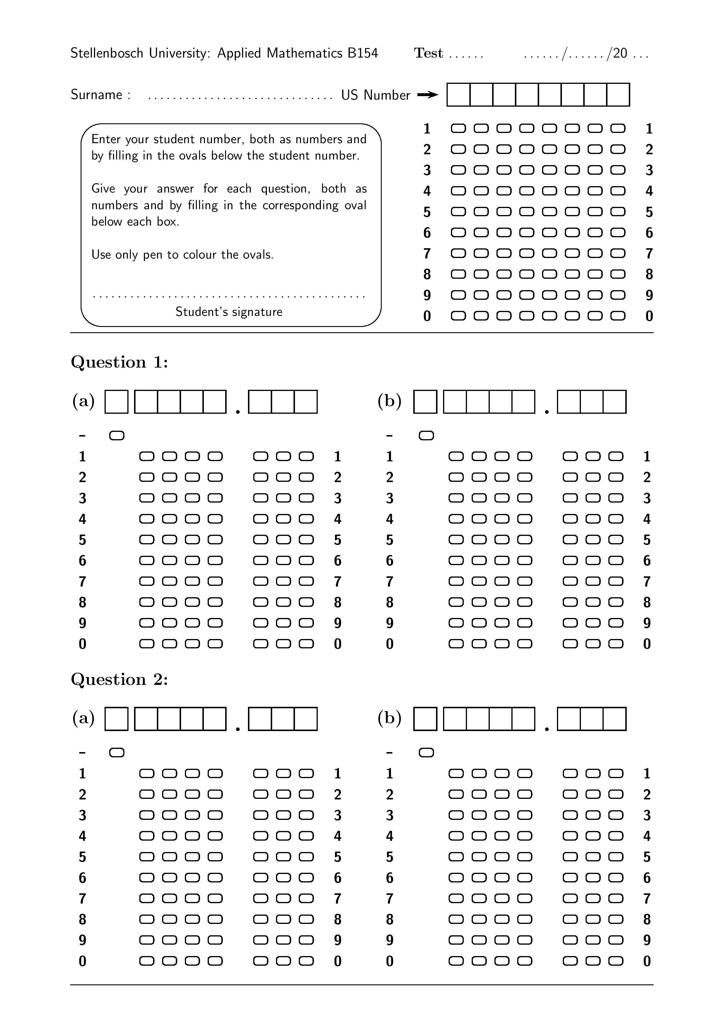
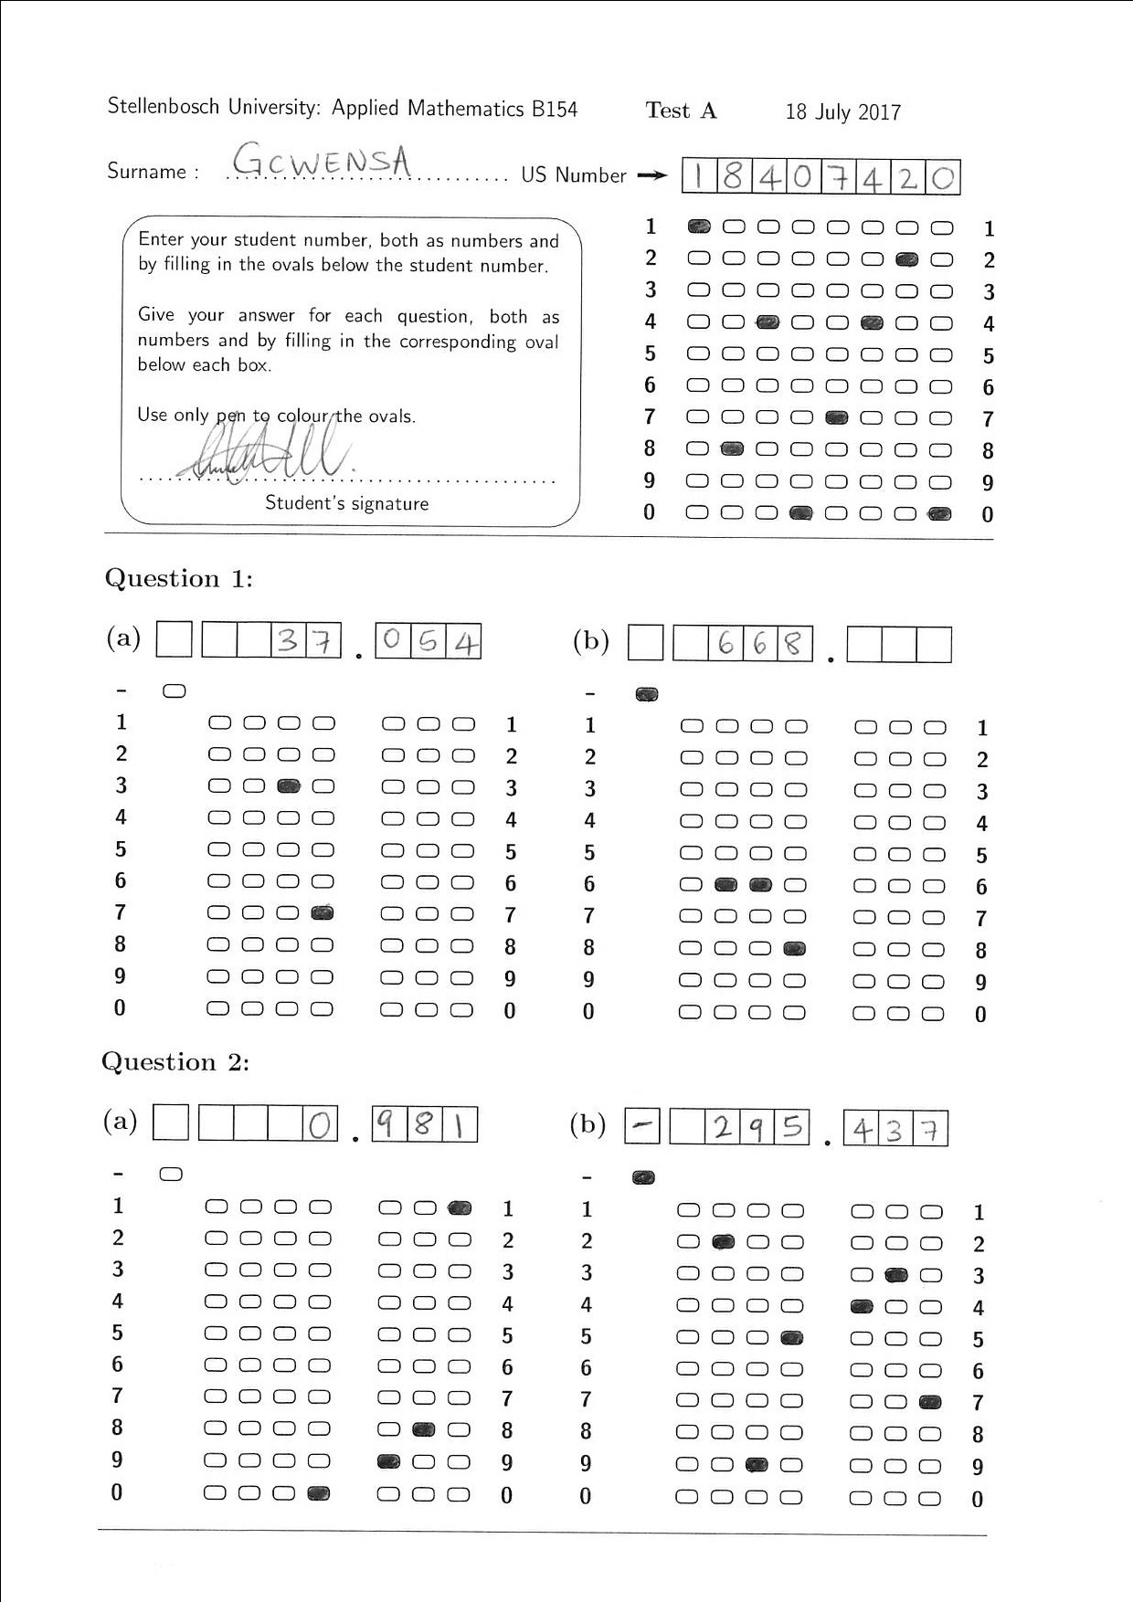
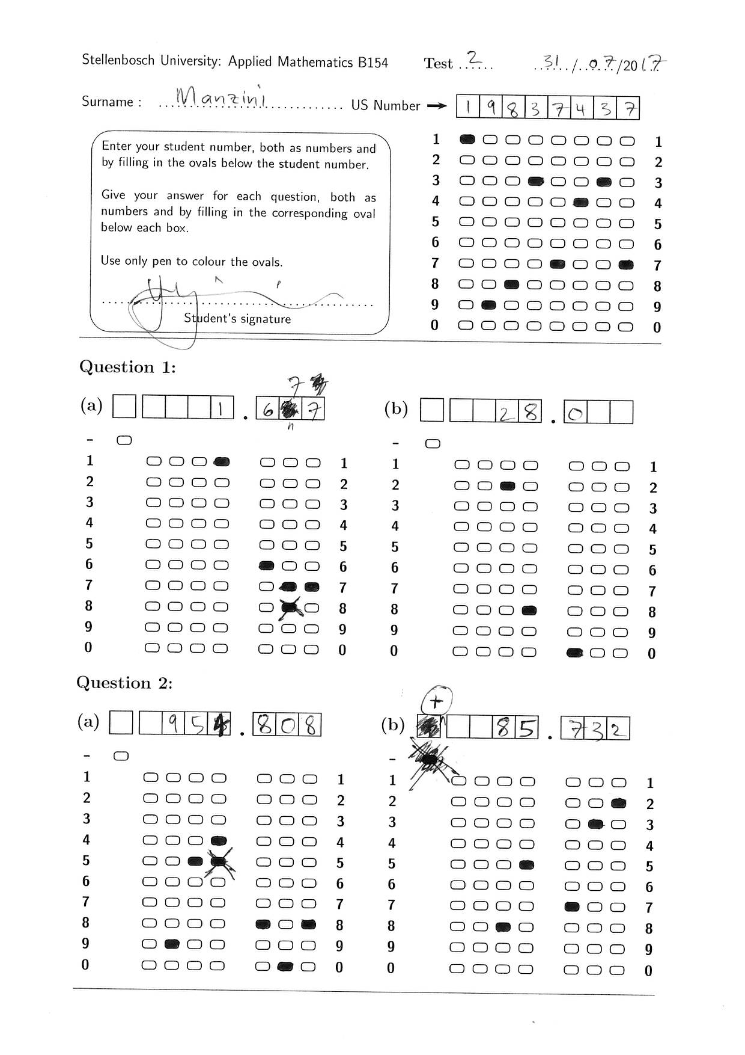
Overview

Slide 3
Image Processing

Slide 5
Machine learning: Neural Network

Slide 6
Machine Learning: Probabilistic Graphical Models

Slide 7
Results

